Slide 1
It’s About Time: Using Survival Analysis to Gain Time-Based People Insights
A SIOP Master Tutorial
SHL
April 4, 2019

Slide 2
Tutorial Objectives
The tutorial is intended to help participants develop a deeper understanding of Survival Analysis and its relative strengths over more commonly used techniques such as logistic regression.
Participants will:
Learn the different areas of application of Survival Analysis
Become familiar with the relative advantages of this technique over more commonly applied methods
Understand what types of data are best suited for Survival Analysis
Experience a step-by-step implementation of the technique on a real-world case study
Receive guidance on how to interpret and use the results of Survival Analysis
We will share working R code used for the tutorial with all participants.
The tutorial is NOT:
Intended to teach R as a language, but rather to make use of it as a tool for modeling, plotting, and making predictions about events that unfold over time.

Slide 3
Overview of Survival Analysis
An IO Lens to Time-based Modeling
Case Study
Summary and Conclusions

Slide 4
Overview of Survival Analysis
Survival analysis is an analytical method that provides dynamic insight into the likelihood of event of interest.
Its application was popularized in medical clinical trials where the event of interest is often death, an adverse drug reaction, or the development or recurrence of a disease.
When applying this method to HR, “survival” is the time-period free of an event of interest.
The technique is generalizable to any research question which can be formulated as time-to-event analysis.
Turnover: Time to attrition; time to voluntary attrition. We will focus on this for the most part of the tutorial.
Performance: Time to 90% productivity; time to fully meeting sales quota
Safety: Time to first workplace accident or safety violation
Impact: Time to first patent; time to reach 100 citations
Advancement: Time to promotion; time to merit increase

Slide 5
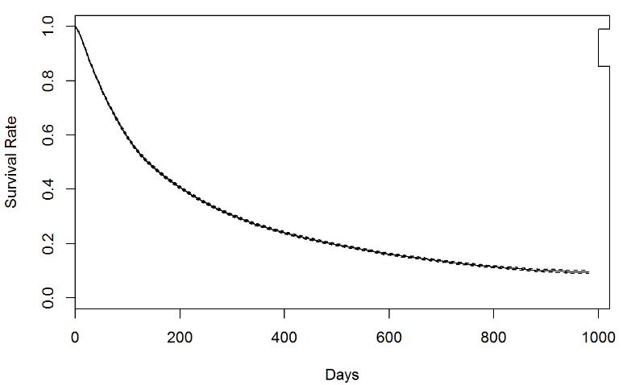
Overview of Survival Analysis
There are two major components of Survival Analysis.
The first component involves plotting and analyzing a survival curve associating survival rate with time.
Plotting these curves requires data on:
Event status and
Time to event (if it occurred), but involves no modeling or prediction.
Different versions of the curve can be plotted for and contrasted across different forms a given predictor can take (e.g. by different countries) to extract initial insights into which factors lead to longer or shorter survival times

Slide 6
Overview of Survival Analysis
The second component involves assessing the association between multiple predictors or risk factors, considered simultaneously, to survival rate/risk over time.
The relationship is often captured using the Cox Proportional Hazards Regression Model, the most commonly used regression technique for survival analysis.
More specifically, the model estimates hazard rate – the risk or probability of suffering the event of interest at any given time – given a set of potential risk factors.
Survival times of participants can then be inferred from hazard rates.

Slide 7
Survival Analysis For People Analytics
Survival Analysis can address a range of broad questions such as:
What is the change in the individual likelihood of attrition at any given point in time if employees that ask to work from home are allowed to do so?
What is the change in the individual likelihood of promotion if employees participate in a mentoring program?
What is the change in the individual likelihood of reaching a sales quota at any given point in time if a senior seller accompanies a junior seller on 3 client visits?
Business leaders often ask HR to quantify the ROI of a new program or policy change, without Survival Analysis in their analytical toolkit, they will struggle to demonstrate
The impact of the program on a given person under their specific circumstances and at a specific time, rather than on the population as a whole and
How soon the program will make an impact or how quickly the end result can be pulled forward.

Slide 8
The Relative Advantages of Survival Analysis Over Conventional Methods
Because it is specific to time-based questions, survival analysis has three very unique advantages over the modeling approaches typically applied to such problems:
1. A single model allows analysts to estimate individual-level probabilities at any chosen point in time (e.g., 30-day, 95-day, one-year, and five-year) without repeating the analysis.
2. Survival analysis allows researchers to include incomplete data on survival time. In a study of time to attrition, some employees may have been hired only 20 days ago and it is not known whether they will survive for 60, 90 or 180 days. What is known in such situations is the elapsed time during which the event has not yet taken place.
3. Survival analysis provides a way to incorporate such incomplete information whereas typical regression methods would exclude it entirely from subsequent modeling process. This increases the available sample size and improves overall accuracy.

Slide 9
Overview of Survival Analysis
An IO Lens to Time-based Modeling
Case Study
Summary and Conclusions

Slide 10
Analytical Technique Influences Theory
Somers (1996): Compares regression methods to survival analysis in modelling turnover
Found that Job Search Behavior (JSB) predicts turnover when using OLS or logistic regression, provides support for a Reasoned Action model of turnover (Fishbein & Ajzen, 2011)
However, when using survival analysis, JSB was no longer a significant predictor
Multiple researchers in the organizational sciences (e.g., Mobley, 1977; Morita, Lee, & Mowday, 1993; Sommers, 1996) have called for the use of analytical techniques which account for time, especially in studying turnover.
This has not happened – recent papers continue to highlight this issue (e.g., Steel, 2002; Kammeyer-Mueller, Wanberg, Glomb, & Ahlburg, 2005; Sheng & Lee, 2018).
(Birnbaum & Somers, 1993; Wahba, 1988)
Job satisfaction
Job search behavior
Intent to leave
Turnover
(Somers, 1996; Darden, 1987)

Slide 11

Why Haven’t We Responded to This Call?
Allen and colleagues (2014) review of the literature
447 empirical studies over 52 years
Broadened the issue to also include the design of the research method, not just the analytical technique.
E.g., Majority of papers used cross-sectional or static cohort research designs (also recognized by Steel, 2002)
Conclude that there is a “Dominant Analytical Mindset” (DAM) in the study of turnover
Slowing theoretical progress in two ways:
1. constraining conceptualization of research questions
2. encouraging research practices which constrain explanatory power
Suggest incorporating time into our research designs and analyses
“Regression Dam”
Notes:
Research design, data collection, and measurement in addition to analytical strategies
Analytical mindsets are manifested in the methodological choices scholars make
Content analysis – methods and theory of 447 empirical turnover studies over 52 years
find evidence supporting the existence of a DAM. We further argue that, analogous to a physical dam, this DAM may be slowing theoretical progress in at least two ways: by constraining the conceptualization of research questions, variables, and relationships and by encouraging research practices that constrain explanatory power
Suggestions
Use more diverse quant strategies: Survival analysis, growth modeling, SNA, multilevel modeling
Include time: 60% static cohort/cross sectional design, experience sampling methods
Experimental/quasi-experimental design
Contra Dam, in Switzerland
The time horizon associated with each study was coded as cross-sectional (data on all variables collected at one point in time), static cohort (data on all independent variables collected at one point in time with turnover data collected at some later point in time), longitudinal (data on independent variables alsoseparated intime), repeated measures (data on independent variables collected on multiple occasionsover time), retrospective (data on some variables collected by participant recall), and ex post archival (data on some variables collected from organizational records spanning previous periods)
Longitudinal only 20%; 50% static cohort (two time points, ivs, and turnover yes/no)

Slide 12
Breaking the DAM
Two reasons why survival analysis hasn’t been more widely used:
Unfamiliarity with the prior literature
Somers, M. J. (1996). Modelling employee withdrawal behaviour over time: A study of turnover using survival analysis. Journal of Occupational and Organizational Psychology, 69(4), 315-326.
Mobley, W. H. (1977). Intermediate linkages in the relationship between job satisfaction and employee turnover. Journal of applied psychology, 62(2), 237.
Steel, R. P. (2002). Turnover theory at the empirical interface: Problems of fit and function. Academy of Management Review, 27(3), 346-360.
Kammeyer-Mueller, J. D., Wanberg, C. R., Glomb, T. M., & Ahlburg, D. (2005). The role of temporal shifts in turnover processes: it's about time. Journal of Applied Psychology, 90(4), 644.
Allen, D. G., Hancock, J. I., Vardaman, J. M., & Mckee, D. L. N. (2014). Analytical mindsets in turnover research. Journal of Organizational Behavior, 35(S1), S61-S86.
Unfamiliarity with the technique
But not for much longer …
Notes:
Unfamiliarity among academics and practitioners with the prior literature that has identified techniques such as survival analysis as being particularly well-suited to this area of research (e.g., Sommers, 1996).
Academics and practitioners alike may not know how to use these alternative techniques (e.g., survival analysis).

Slide 13
Overview of Survival Analysis
An IO Lens to Time-based Modeling
Case Study
Summary and Conclusions

Slide 14
Retail Sales Associates Case Study
To illustrate the power of Survival Analysis for attrition modeling, we will present one in-depth case study on a sales associate role.
The data for this study comes from a retailer that hired 53,494 sales associates between January 2013 and January 2016.
For each hire, this retailer collected a variety of information, including education level, prior employment, days available, and desired hours, as well as the results of a psychometric test battery.
The retailer then supplied the termination date for each sales associate or indicated if they were still employed as of the data extraction date.

Slide 15

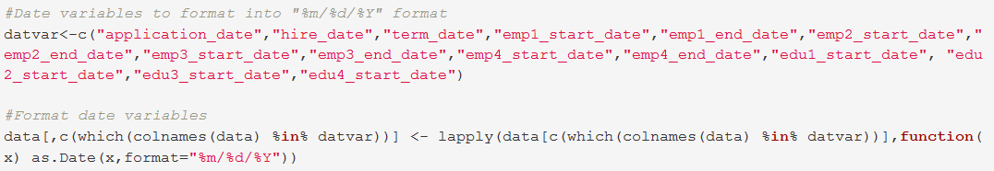
Preparing Data
Prepare Data
Analyze Survival Curves
Feature Engineering
Build & Interpret Model
Model diagnostics
Remove temporary positions and involuntary reduction in force
Format date variables (e.g. hire date, termination date etc.) to take the same format.

Slide 16
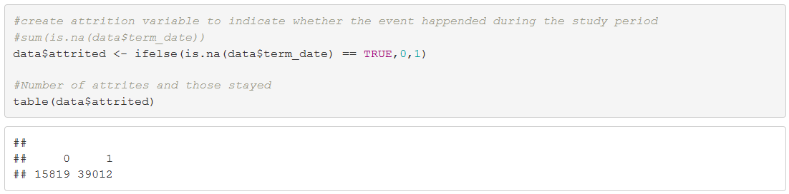
Preparing Data
Prepare Data
Analyze Survival Curves
Feature Engineering
Build & Interpret Model
Model diagnostics
Exclude employees that have hire data after term date, perhaps due to incorrect data entry.
Create attrition variable (1 if there is a termination date, 0 otherwise).

Slide 17
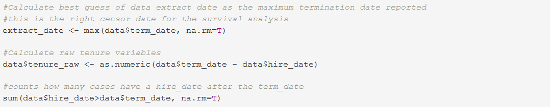
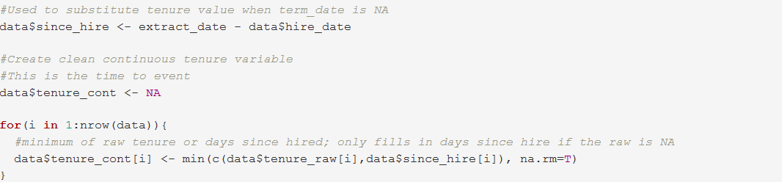
Preparing Data
Prepare Data
Analyze Survival Curves
Feature Engineering
Build & Interpret Model
Model diagnostics
Time-to-event (tenure) calculation
It is the difference between termination and hire date for those who left the company by the time the data for this case study was pulled.
What about for those who did not yet leave by the time the data was pulled?
We can use the difference between data pull date and hire date. What if we don’t know the exact day the data was pulled on? Calculate best guess of data pull date as the maximum termination date reported.

Slide 18
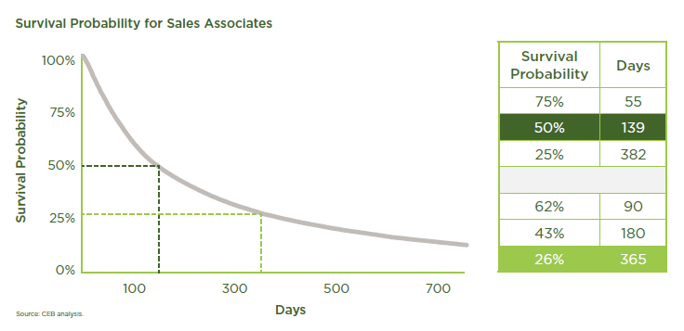
Survival Curves
Prepare Data
Analyze Survival Curves
Feature Engineering
Build & Interpret Model
Model diagnostics
The figure shows the probability of surviving (y axis) versus time in days (x axis).
Creating a survival probability plot to examine turnover is different than simply calculating turnover rates (number leaving/headcount *100%) and much more informative.
Turnover in this role is rapid.
About 75% of new hires survive past 55 days. 25% leave within 55 days of start date.
Only about 26% remain past their first year. 75 % leave within their first year or so.

Slide 19
Acting on Survival Curve Information Alone
Prepare Data
Analyze Survival Curves
Feature Engineering
Build & Interpret Model
Model diagnostics
Survival curves alone can provide value to a wide range of internal HR teams. Based on the current example:
The recruiting team can estimate the number of new hires required to keep all positions filled.
The training team can use it to estimate the attendance in classes that align with employee tenure. For example, this curve says that, among those attending a new hire orientation class on day 1, only 62% would still be employed to attend another class 90 days later.
The benefits team can use the model to estimate costs and utilization for any benefits that have tenure minimums. For example, if a work anniversary gift is offered as a perk for employees staying past 1 year, this curve says that only 26% of new hires will ever qualify for this benefit.
The leadership development team can refine this model by zooming in on the period past 365 days and restating the question as, “Given that someone has already stayed for 365 days, what factors determine their continued survival or their likelihood of promotion?”

Slide 20
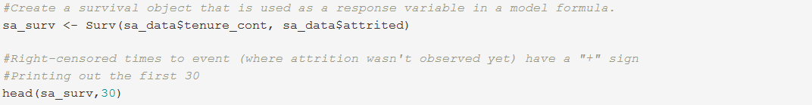
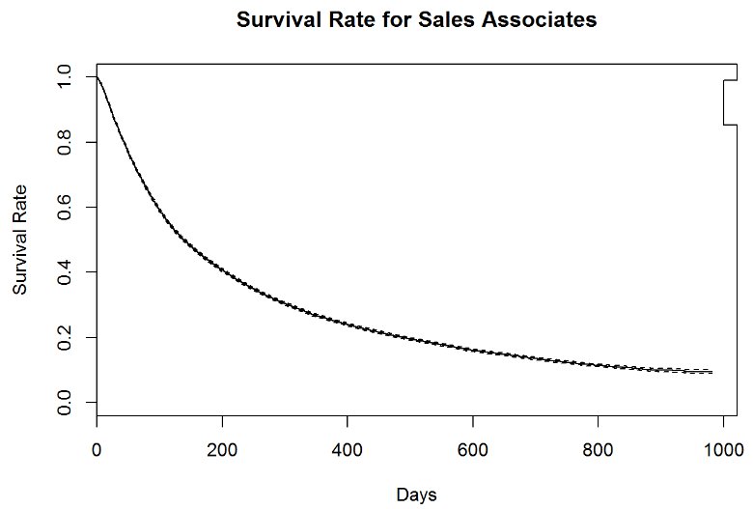
Plotting the Curve
Prepare Data
Analyze Survival Curves
Feature Engineering
Build & Interpret Model
Model diagnostics
Step 1: Create a survival object that is used as a response variable
Step 2: Fit a model to the response variable with intercept only
Step 3: Plot the curve

Slide 21
Exploring Attrition Risk Factors
Prepare Data
Analyze Survival Curves
Feature Engineering
Build & Interpret Model
Model diagnostics
We encourage you to explore your data visually using hypotheses about your own attrition risk factors.
To illustrate how to conduct a visual exploration, we tested six hypotheses for the sales.
Attrition Risk Varies by:
Whether the person applied to the sales associate role or the sales leader role originally,
Highest level of education obtained,
Psychometric assessment score,
Rehire status,
Times available for work, and
Store location.
By examining the survival curves visually, the risk factors and their relative importance begin to reveal themselves even before creating a mathematical model.

Slide 22
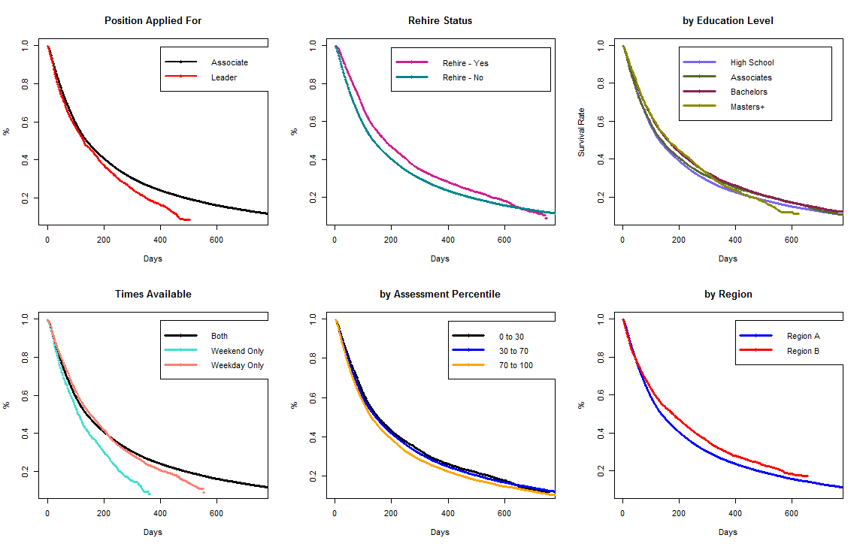
Finding the Risk Factors Visually
Prepare Data
Analyze Survival Curves
Feature Engineering
Build & Interpret Model
Model diagnostics
Plotting the data shows the researcher which factors affect survival, while the specific shapes of the curves provide information about the strength and timing of the effect.
The surviving percentage decreases (attrition increases) relatively more rapidly among sales associates who
Applied for the more senior sales leader position but were hired at the associate level
Two-year survival curves
Didn’t previously work for the retailer (not a rehire)
Have a highest education level of high school or associate’s degree
Are available only on weekends
Have a high psychometric assessment score, and are working in a store based in Region A

Slide 23
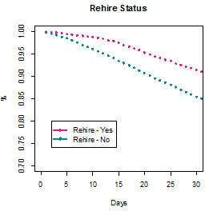
Finding the Risk Factors Visually
Prepare Data
Analyze Survival Curves
Feature Engineering
Build & Interpret Model
Model diagnostics
By plotting the survival curves for a two-year period and also for a 30-day period, we see that some of these hazards are more significant and pronounced in the first 30 days of the role, while others begin to exert their effect later.
Stating on your application that you are available only on weekends makes it essentially certain that you will not stay for two years (0% survival rate), yet there is no difference in attrition based on availability across the first three weeks of employment.
Being a rehire has much more positive impact in the short-run than later.
This level of insight is only available from a time-based study of attrition and is one of the reasons we favor survival analysis over traditional point-in-time turnover models.
Vs.
Vs...

Slide 24
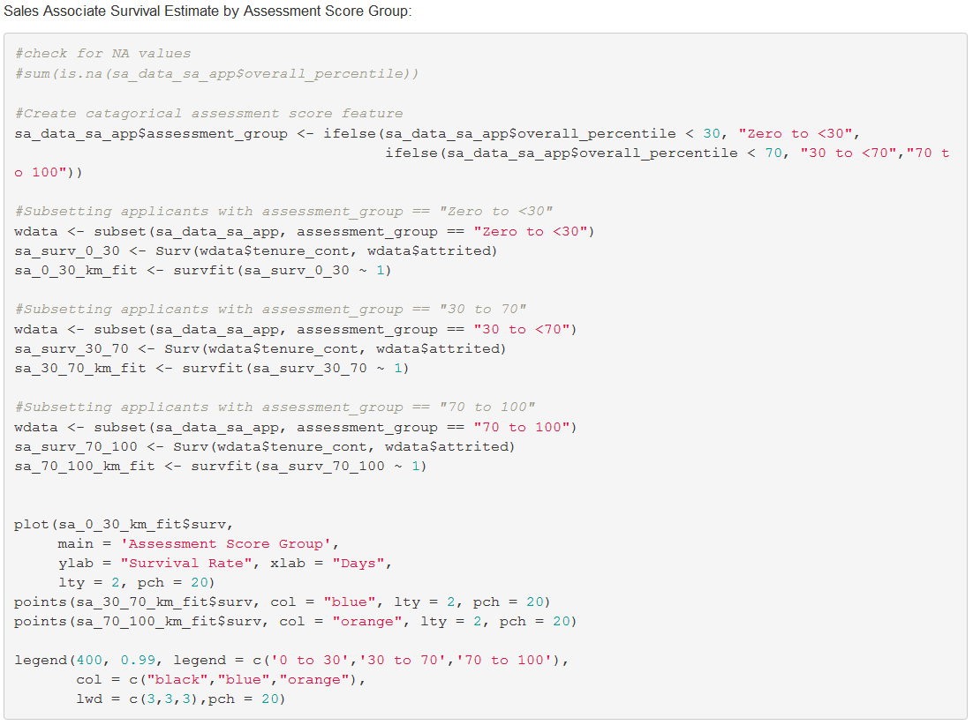
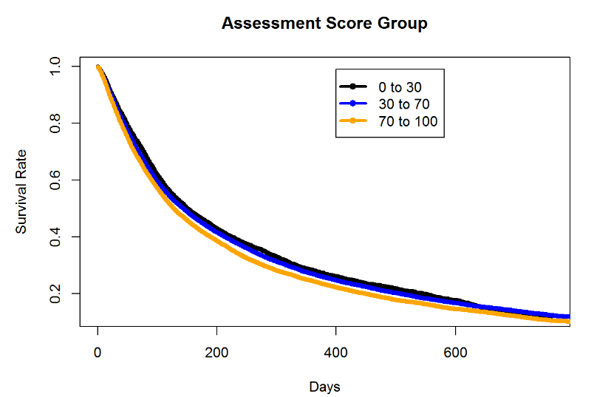
Sample R Code for Visual Explorations
Prepare Data
Analyze Survival Curves
Feature Engineering
Build & Interpret Model
Model diagnostics

Slide 25
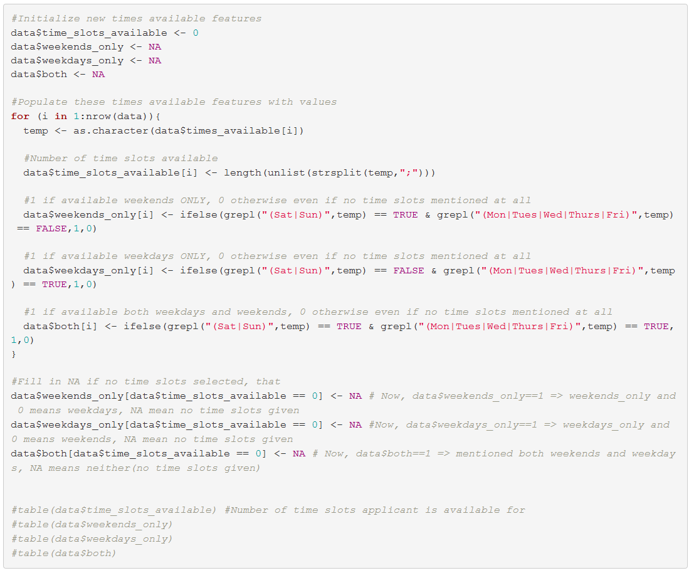
Sample R Code for Feature Engineering
Prepare Data
Analyze Survival Curves
Feature Engineering
Build & Interpret Model
Model diagnostics

Slide 26
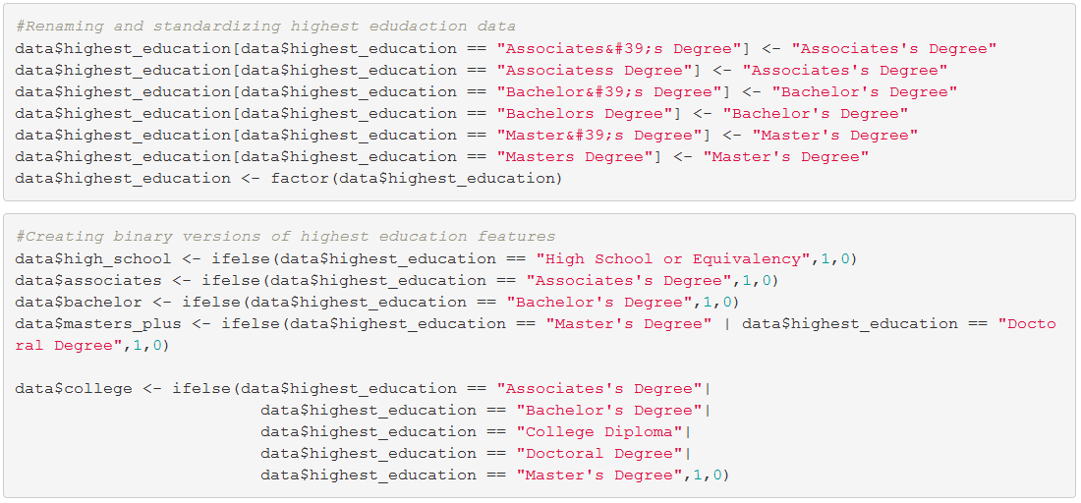
Sample R Code for Feature Engineering
Prepare Data
Analyze Survival Curves
Feature Engineering
Build & Interpret Model
Model diagnostics

Slide 27
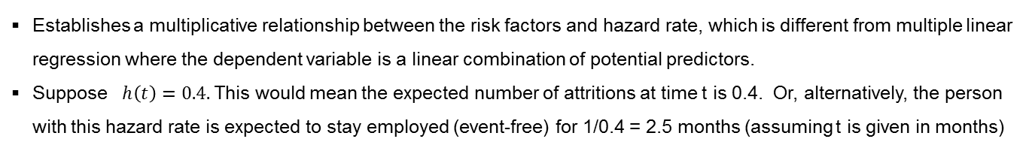
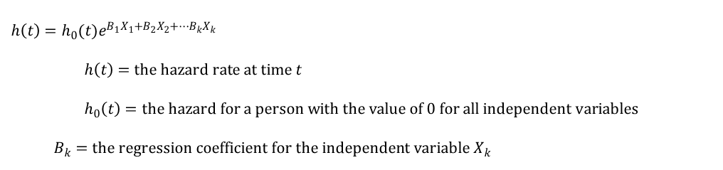
Cox Proportional Hazards Regression Model
Prepare Data
Analyze Survival Curves
Feature Engineering
Build & Interpret Model
Model diagnostics
While survival curves help understand the survival probability for a particular population, HR teams also need to understand the variables that affect time-to-turnover in order to extend average tenure.
Fitting a Cox Proportional Hazards Model to the data results in an equation with the following form:
$$h\left(t\right)=h_{0}(t)e^{B_{1}X_{1}+B_{2}X_{2}+…B_{k}X_{k}}$$
$$h\left(t\right)=the hazard rate at time t \\ h_{0}\left(t\right)=the hazard for a person with the value of 0 for all independent variables$$
$$B_{k}=the regression coefficient for the independent variable X_{k}$$
Establishes a multiplicative relationship between the risk factors and hazard rate, which is different from multiple linear regression where the dependent variable is a linear combination of potential predictors.
Suppose $h\left(t\right)=0.4.$ This would mean the expected number of attritions at time t is 0.4. Or, alternatively, the person with this hazard rate is expected to stay employed (event-free) for 1/0.4 = 2.5 months (assuming t is given in months)

Slide 28

Cox Proportional Hazards Regression Model
Prepare Data
Analyze Survival Curves
Feature Engineering
Build & Interpret Model
Model diagnostics
An alternative way of expressing the Cox PH model is to represent natural logarithm of relative hazard term as a linear combination of the risk factors.
$$\ln{\frac{h\left(t\right)}{h_{0}(t)}=}B_{1}X_{1}+B_{2}X_{2}+…B_{k}X_{k}$$
This is a more familiar look as the right hand side looks like multiple linear regression model.
Fitting a Cox PH model involves figuring out the coefficients associated with each risk factor.
Once the risks and coefficients are known, it is possible to calculate the risk of the event at any given time for each participant.
The model expression with relative hazard term above makes the interpretation of model coefficients easier as we will see shortly.

Slide 29
Cox Proportional Hazards Regression Model
Prepare Data
Analyze Survival Curves
Feature Engineering
Build & Interpret Model
Model diagnostics
The following attrition risk factors are used in the Cox model
assess_0_30: scored between 0 and 30
assess_30_70: scored between 30 and 70
assess_70_100: scored between 70 and 100
weekends_only: available only weekends
weekdays_only: available only weekdays
Both: available 7 days a week
sa_app: applied as sales associate
sl_app: applied as a sales leader
Rehire: a rehire
high_school: high school is the highest education
Associates: Associate is the highest education
Bachelor: Bachelor’s degree is the highest education
Masters_plus: Master’s or higher is highest education

Slide 30
Fitting Cox Proportional Hazards Regression Model
Prepare Data
Analyze Survival Curves
Feature Engineering
Build & Interpret Model
Model diagnostics
Model summary
Variable | β | exp(β) | P-value
Assessment scores 0-30 | -0.15 | 0.86 | <0.001
Assessment scores 30-70 | -0.08 | 0.92 | <0.001
Weekends_Only | 0.23 | 1.26 | <0.001
Applied as Associate | -0.08 | 0.92 | 0.004
Rehire - Yes | -0.19 | 0.83 | <0.001
High School | 0.16 | 1.17 | <0.001
Associates | 0.10 | 1.11 | <0.001
Bachelors | 0.04 | 1.04 | 0.09
Concordance= 0.532 (se = 0.002 )
Rsquare= 0.007 (max possible= 1 )
Likelihood ratio test= 351 on 8 df, p=0
Wald test = 344.7 on 8 df, p=0
Score (logrank) test = 345.1 on 8 df, p=0
The likelihood ratio and Wald tests test if the model as a whole is better than the model without any predictor. A very low P-value (< 5%) indicates mode; significance.
Taking the exponent of each coefficients in the model gives a very human-interpretable result.
More precisely,
For individuals available only on weekends the expected hazard is 1.26 times higher relative to people available 7 days, holding all other factors constant.
Being a re-hire carries expected hazard of 0.86 times that of the hazard that comes with being a new hire, holding all other factors constant.
As expected from the visual study, being available ‘weekends only is the greatest hazard, while being a rehire is beneficial (less of a hazard) than being a new hire.

Slide 31
Predicting Survival Rates
Prepare Data
Analyze Survival Curves
Feature Engineering
Build & Interpret Model
Model diagnostics
Using the Cox model, it is possible to predict survival rates for employees for multiple points in time.
Survival Probability of Individual employees
 | 10 Days | 30 Days | 90 Days | 180 Days | 365 Days | 730 Days
Employee 1 | 0.949 | 0.811 | 0.517 | 0.313 | 0.153 | 0.057
Employee 2 | 0.960 | 0.849 | 0.598 | 0.404 | 0.230 | 0.107
Employee 16 | 0.977 | 0.911 | 0.746 | 0.597 | 0.434 | 0.281
Employee 18 | 0.965 | 0.866 | 0.638 | 0.453 | 0.278 | 0.142
Employee 19 | 0.965 | 0.866 | 0.637 | 0.451 | 0.276 | 0.141
Employee 16 has the highest probability of surviving at all time periods.
In fact, at the two-year mark, Employee 16 is almost twice as likely to still be employed as Employee 19 and 5 times as likely to still be employed as Employee 1.

Slide 32
Using Individual Survival Predictions
Prepare Data
Analyze Survival Curves
Feature Engineering
Build & Interpret Model
Model diagnostics
Many different teams within HR can use this type of output in many different ways:
The recruiting team can implement the model for automated application screening and set red, yellow, or green bands for applicants based on their probabilities of surviving past a target date.
The training team can use it to estimate the attendance in classes that align with employee tenure.
The benefits team can use the model to estimate costs and utilization for any benefits that have tenure minimums.

Slide 33
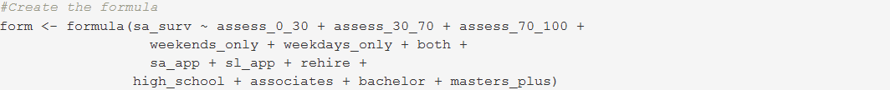
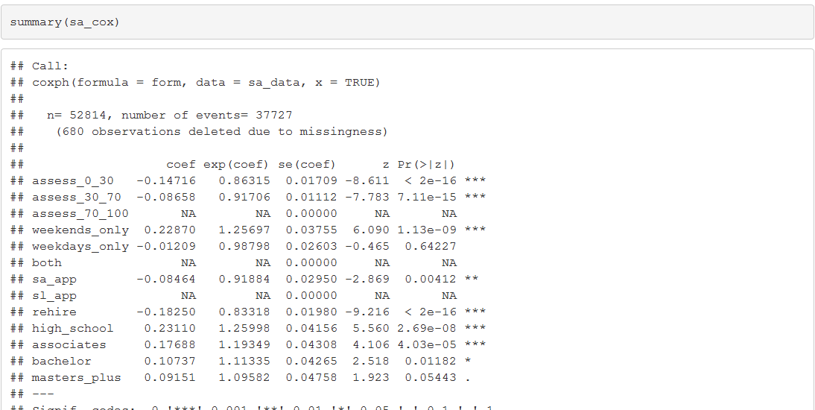
Prepare Data
Analyze Survival Curves
Feature Engineering
Build & Interpret Model
Model diagnostics
Implementing Cox PH Regression Model Using R

Slide 34
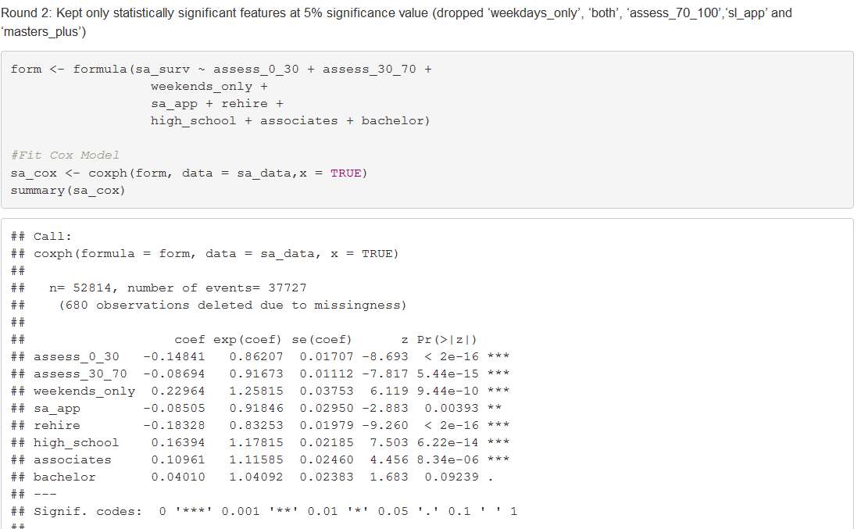
Prepare Data
Analyze Survival Curves
Feature Engineering
Build & Interpret Model
Model diagnostics
Implementing Cox PH Regression Model Using R

Slide 35
Assumptions in Cox Regression
Prepare Data
Analyze Survival Curves
Feature Engineering
Build & Interpret Model
Model diagnostics
A major assumption the technique makes is that the ratio of the hazards for any two individuals is constant over time or changes in predictors produce proportional changes in the hazard regardless of time.
Other assumptions:
There are no observations with outsized influence on the model.
There is a linear relationship between each predictor and log hazard ratio. This is only relevant to continuous predictors.

Slide 36
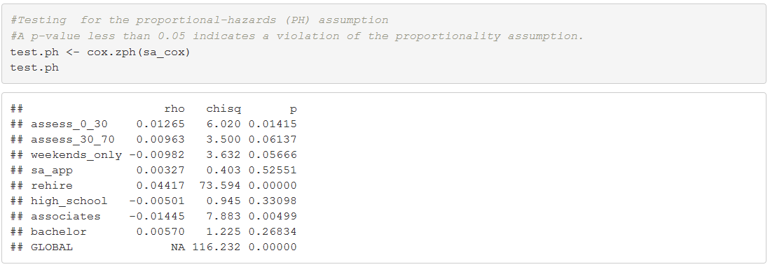
Testing For Assumptions
Prepare Data
Analyze Survival Curves
Feature Engineering
Build & Interpret Model
Model diagnostics
Proportional hazards assumption: The ratio of the hazards for any two individuals is constant over time or changes in predictors produce proportional changes in the hazard regardless of time.
Variable | rho | chisq | P-value
Assessment scores 0-30 | 0.01265 | 6.020 | 0.01415
Assessment scores 30-70 | 0.00963 | 3.500 | 0.06137
Weekends_Only | -0.00982 | 3.632 | 0.05666
Applied as Associate | 0.00327 | 0.403 | 0.52551
Rehire - Yes | 0.04417 | 73.594 | 0.00000
High School | -0.00501 | 0.945 | 0.33098
Associates | -0.01445 | 7.883 | 0.00499
Bachelors | 0.00570 | 1.225 | 0.26834
A p-value less than 5% implies violation of the proportionality assumption. Possible correction mechanisms include:
Adding time-dependent risk factors to the model. Example: Assessment scores 0-30 x Time
Stratification of risk factors that violated the PH assumption.

Slide 37
Overview of Survival Analysis
An IO Lens to Time-based Modeling
Case Study
Summary and Conclusions

Slide 38
Summary and Conclusions
Events such as turnover are inevitable. They will eventually happen to 100% of hires for various reasons.
When an organization hires a new employee, it cares a great deal about how long the person is likely to stay.
When developing interventions to minimize turnover, it is important to determine how much the intervention extends employee tenure, not just whether there is an overall positive ROI.
Other employee outcomes, such as reaching full productivity in a sales role or being promoted, are not inevitable for every individual. They will occur for only a portion of the workforce and they will happen at different times. In these cases, knowing if an event will occur is only part of the story. This tutorial demonstrated the practical value to internal practitioners and line managers of knowing
when these events will occur, and
what they can do to accelerate or delay those events.
Survival analysis’s versatility in addressing such questions at once, ability to generate time-based people insights and its applicability in many different contexts make a compelling case for its adoption.

Slide 39
Thank you. Questions or Thoughts?
Link to slides, R Code and Markdown:
https://github.com/Yebele/Survival-Analysis

